Slide 1
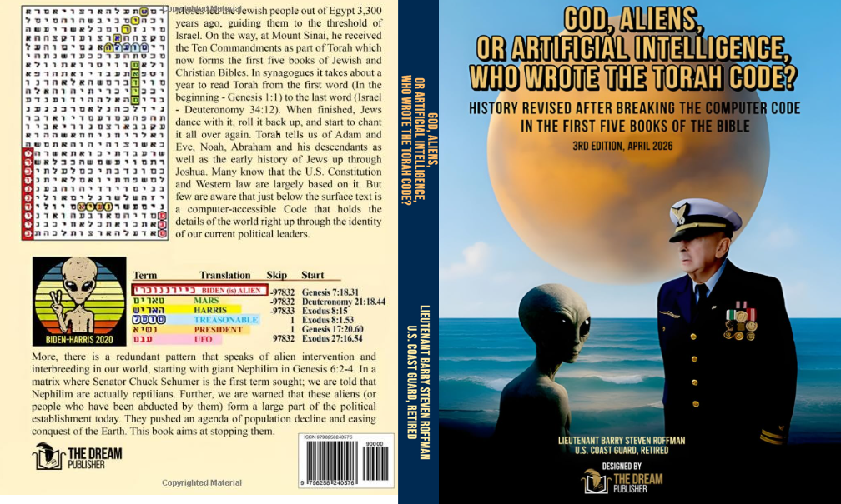
.

Slide 2
TOPICS COVERED IN GOD, ALIENS OR ARTIFICIAL INTELLIGENCE – Who wrote the torah code?
PART 1
1. Martian meteorology
2. NASA disinformation related to the Martian Atmosphere
3. Evidence for primitive life on Mars
4. First contact with an alleged alien
5. Links between the alleged alien and COVID-19.
PA
6. Breaking the Torah Code
7. Scope of political events in the Code
8. Primary purpose of Torah Code as a tool for military intelligence
9. Politicians named in the Code as alien (Reptilian) infiltrators in major governments
10. The exo-political situation

Slide 3
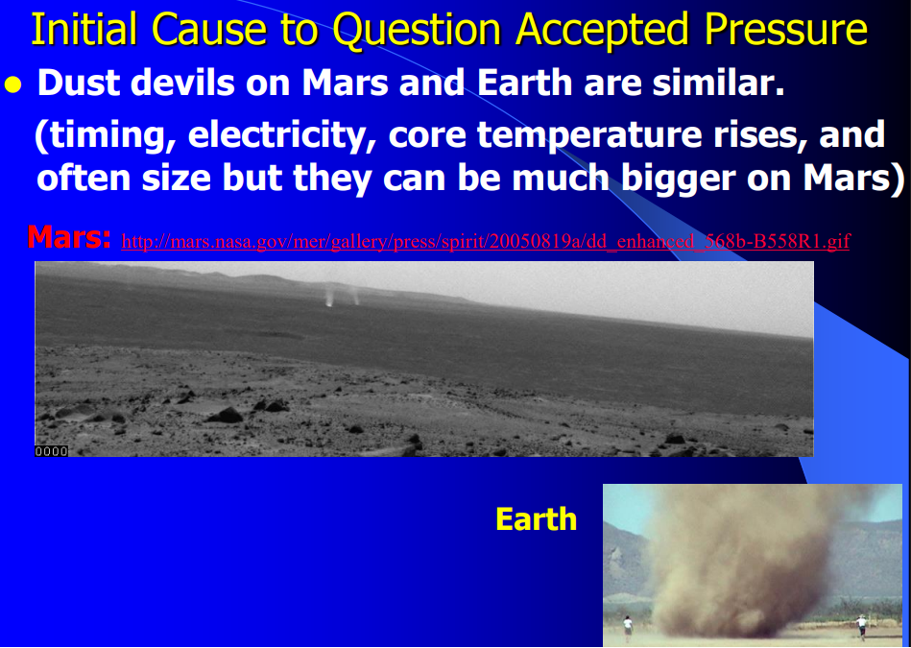
.

Slide 4
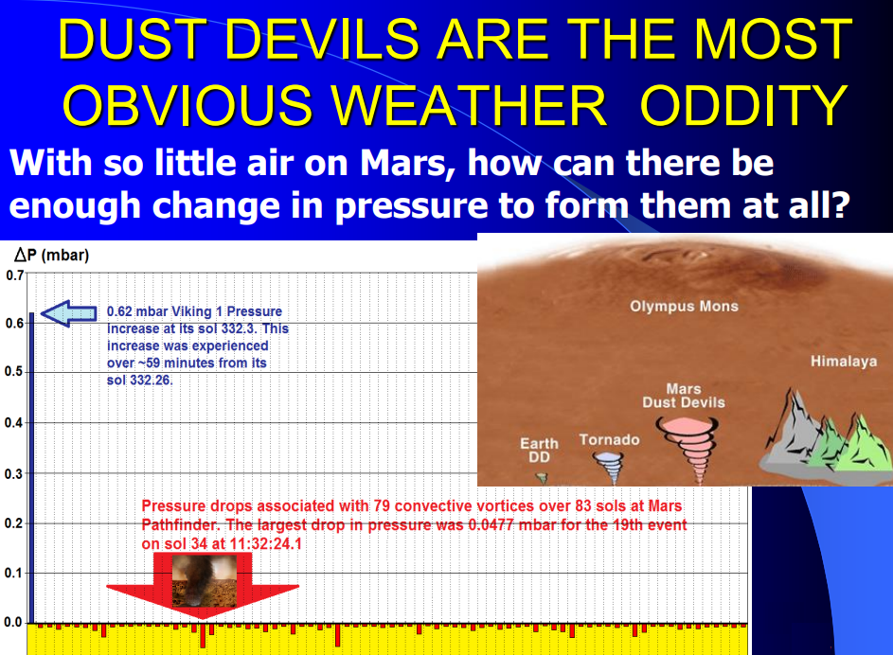
.

Slide 5
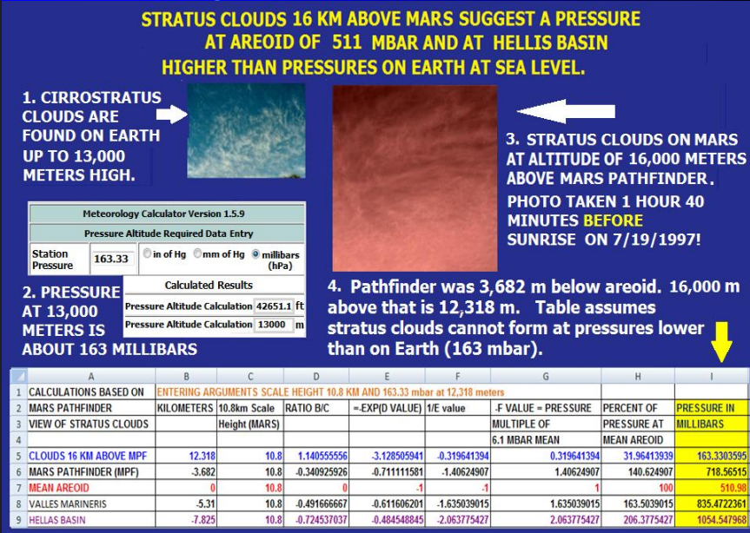

Slide 6
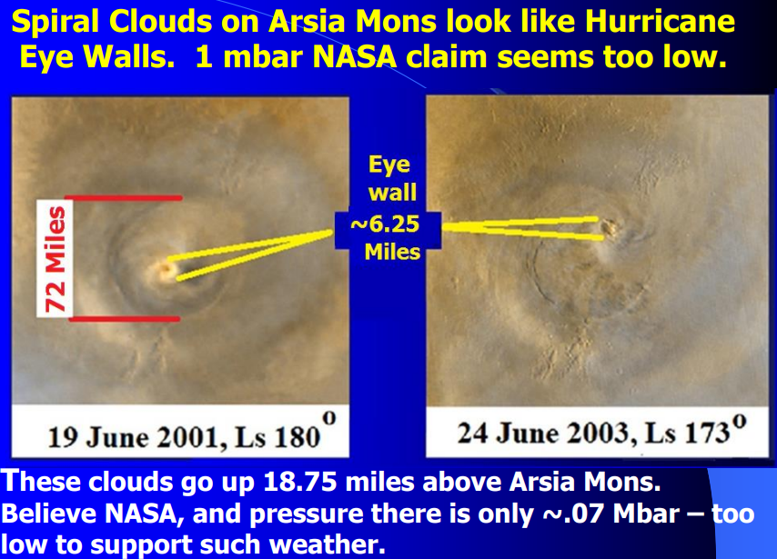

Slide 7
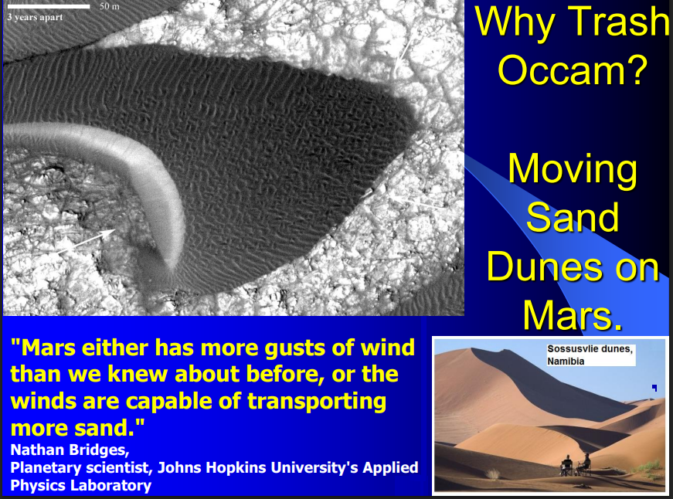

Slide 8
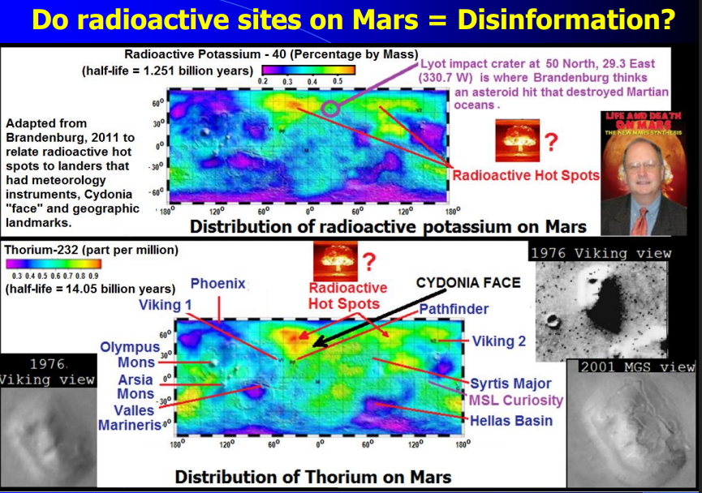

Slide 9
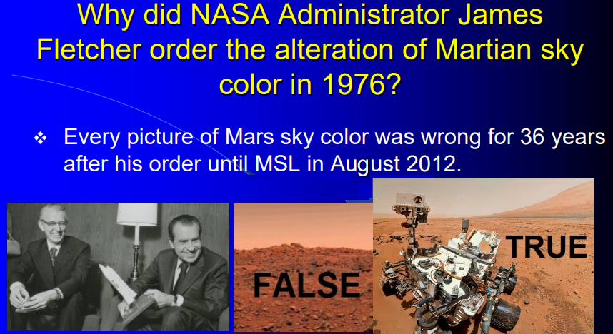

Slide 10
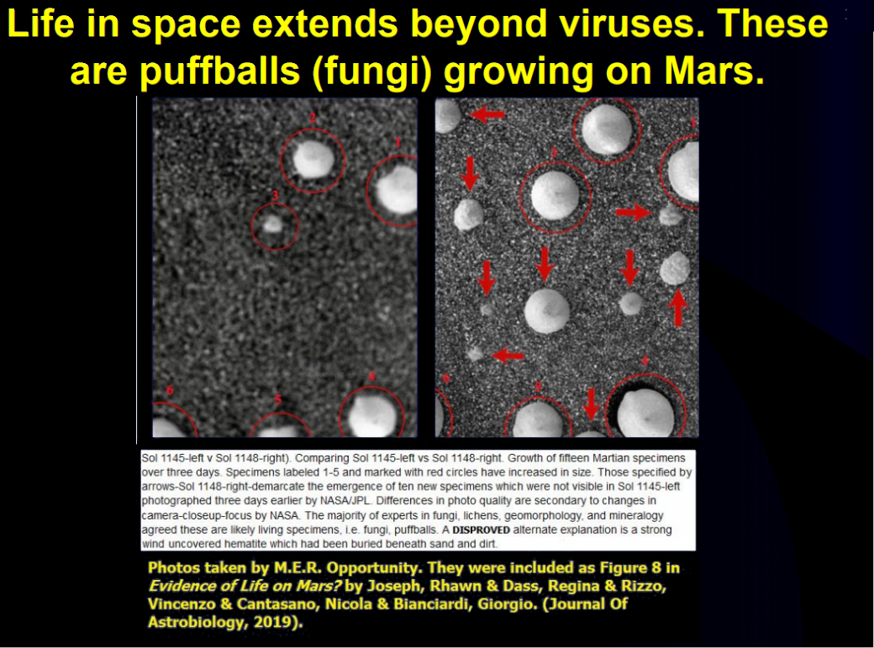
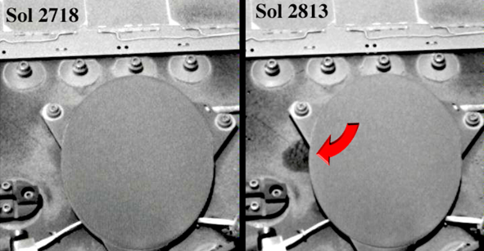
Primitive life seen on Mars
Above: Growth on
Opportunity.

Slide 11
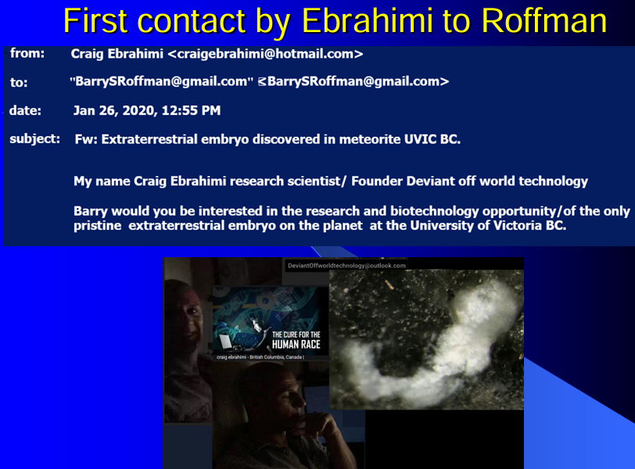

Slide 12
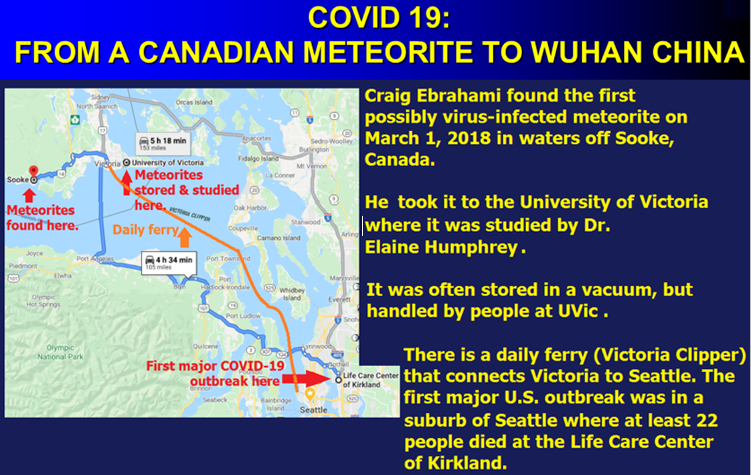

Slide 13


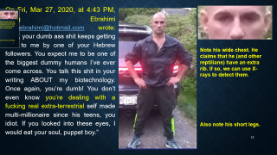
On Fri, Mar 27, 2020, at 4:43 PM, Craig Ebrahimi craigebrahimi@hotmail.com wrote: “Guy, your dumb ass shit keeps getting sent to me by one of your Hebrew followers. You expect me to be one of the biggest dummy humans I’ve ever come across. You talk this shit in your writing ABOUT my biotechnology. Once again, you’re dumb! You don’t even know you’re dealing with a fucking real extra-terrestrial self made multi-millionaire since his teens, you idiot. If you looked into these eyes, I would eat your soul, puppet boy.”
Note his wide chest. He claims that he (and other reptilians) have an extra rib. If so, we can use X-rays to detect them.
Also note his short legs.

Slide 14
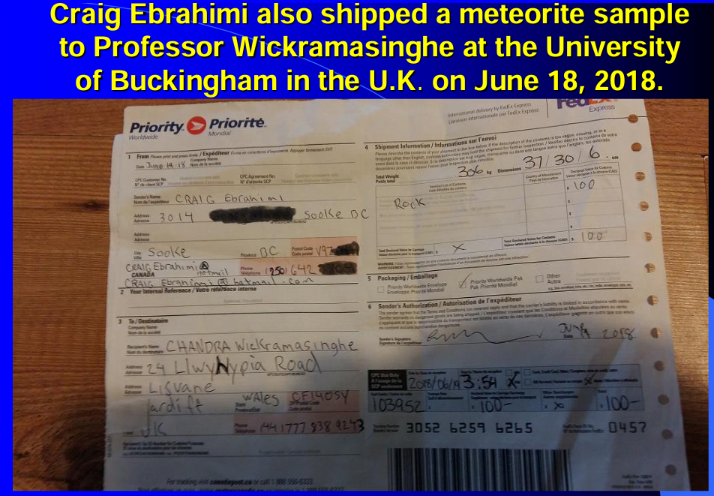

Slide 15
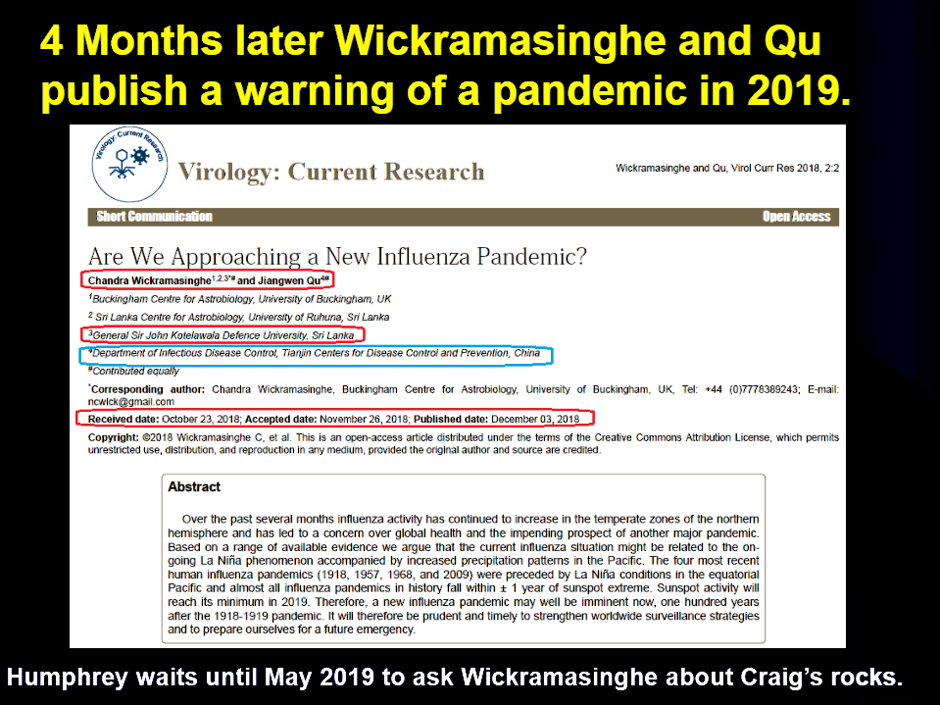
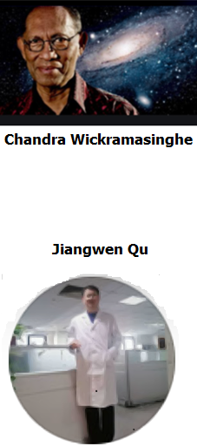

Slide 16
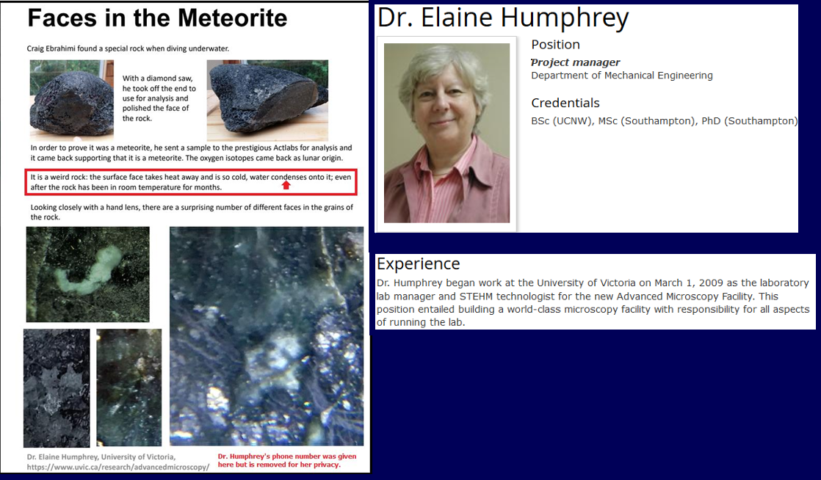

Slide 17
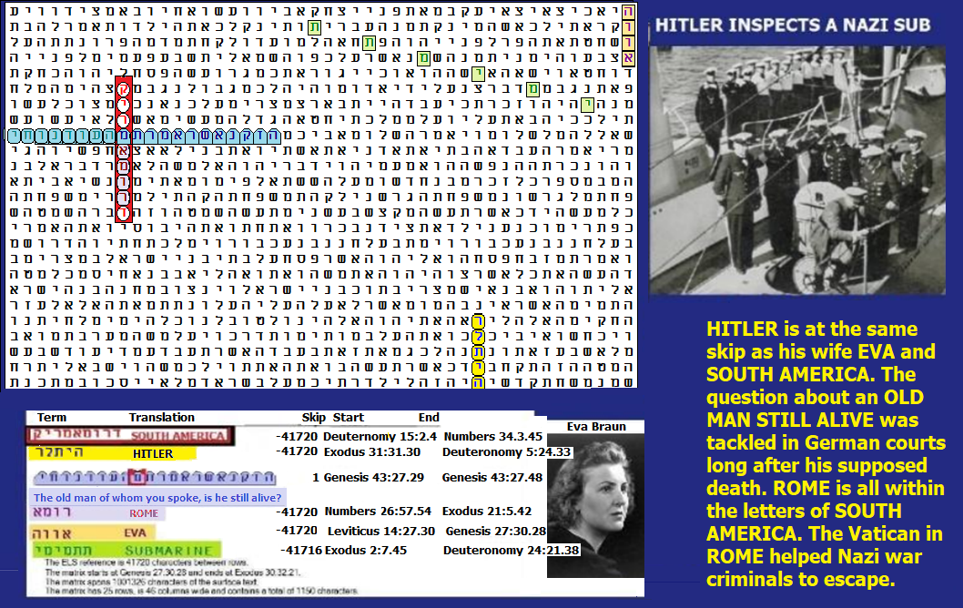
SAMPLE PREDICTIVE Torah code matrices
Odds against this matrix are about: 101,938,865 to 1.

Slide 18
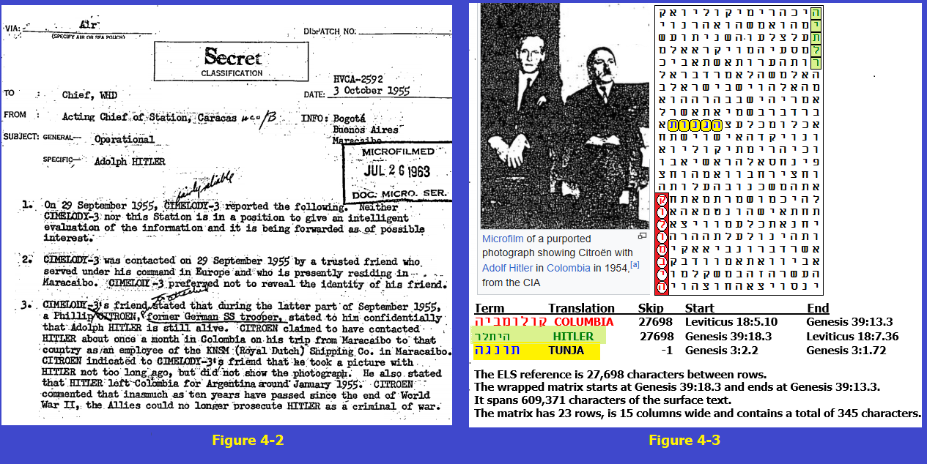

Slide 19
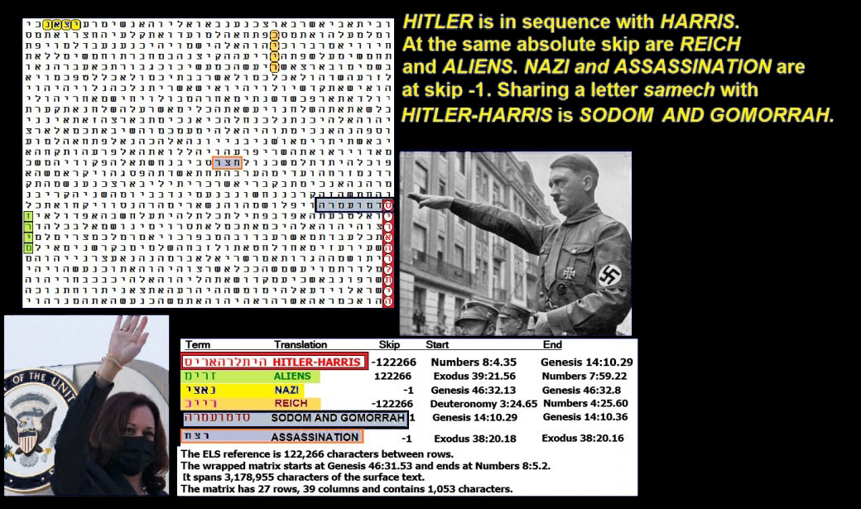

Slide 20
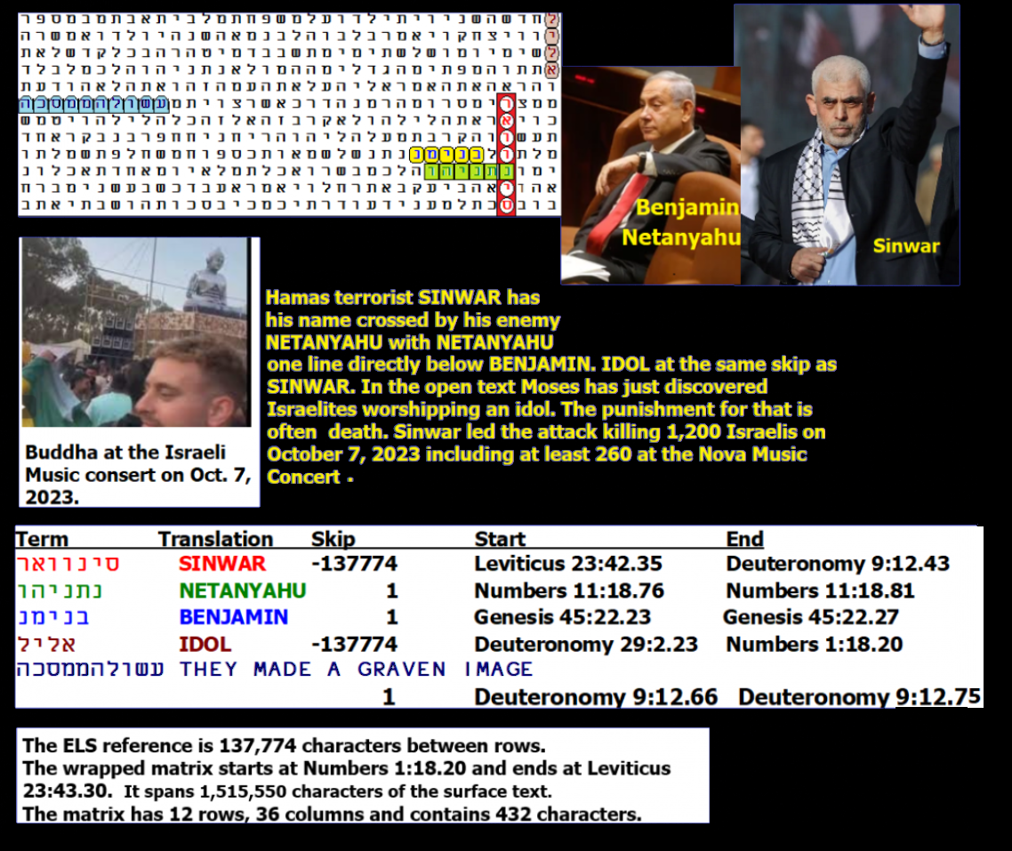

Slide 21
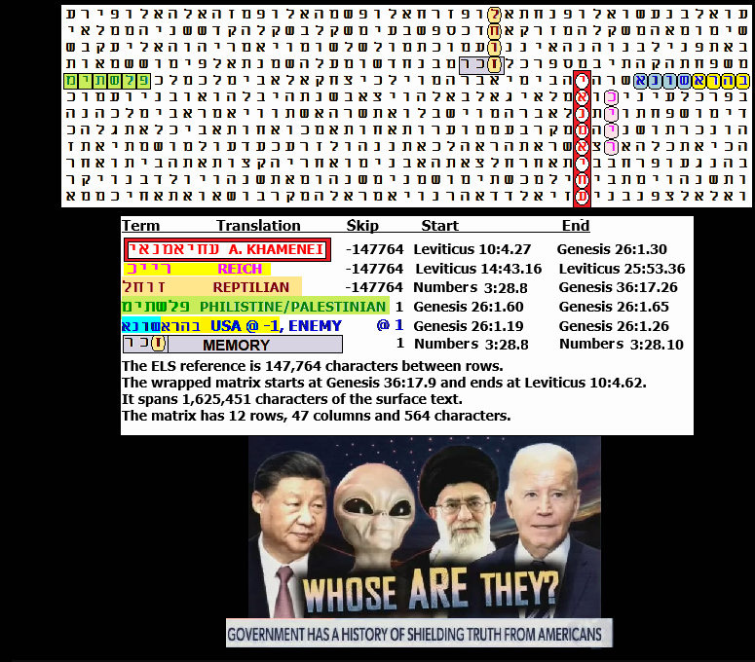

Slide 22
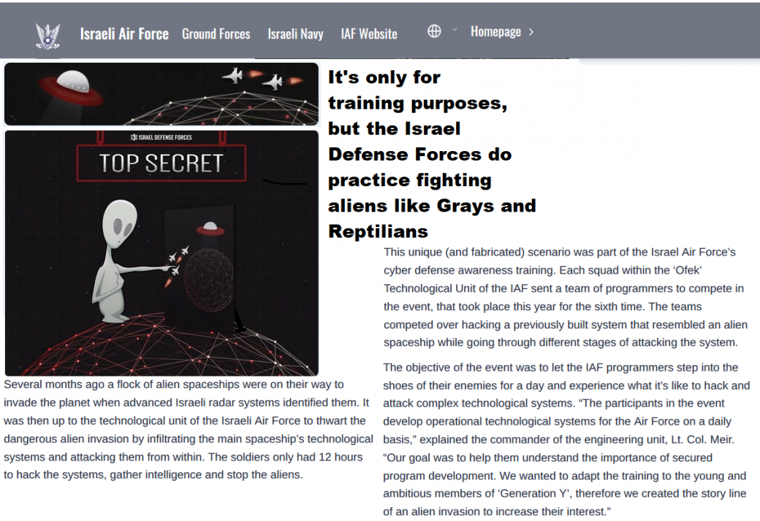

Slide 23
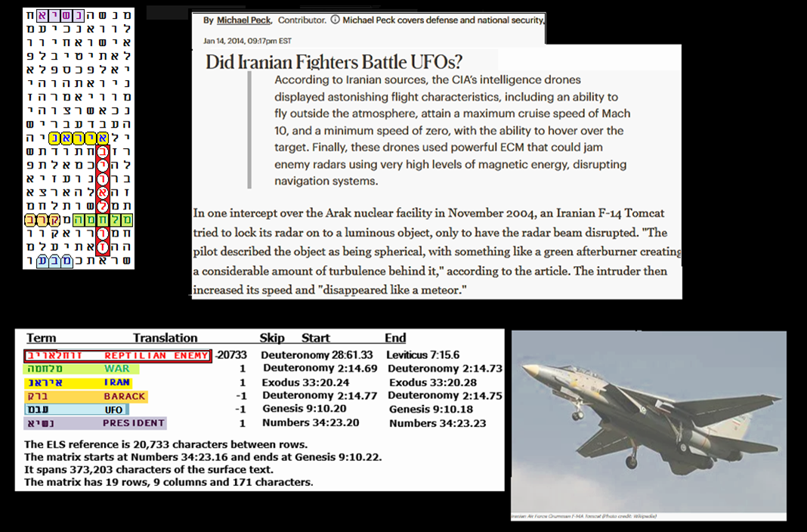

Slide 24
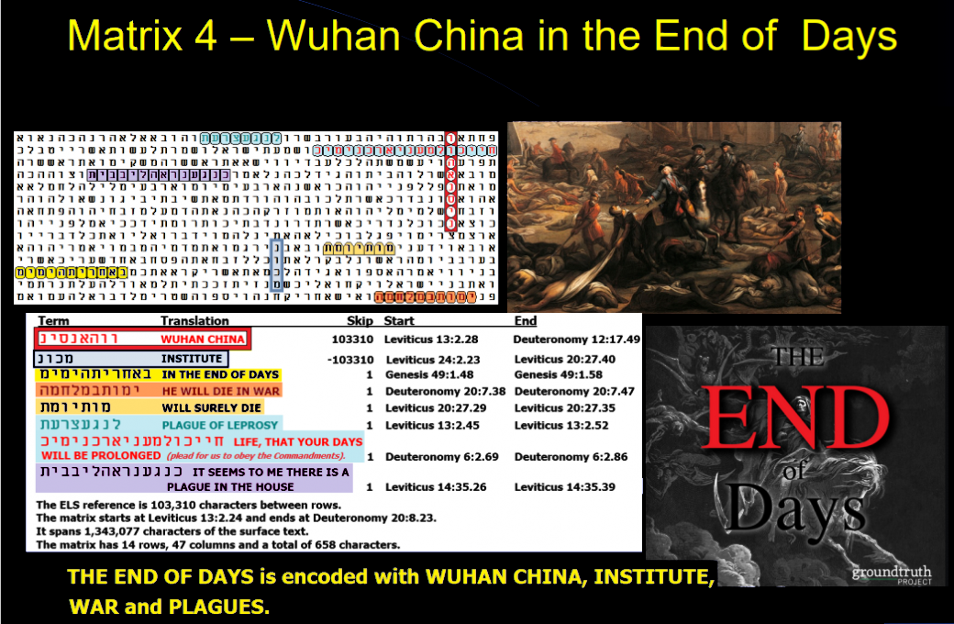

Slide 25
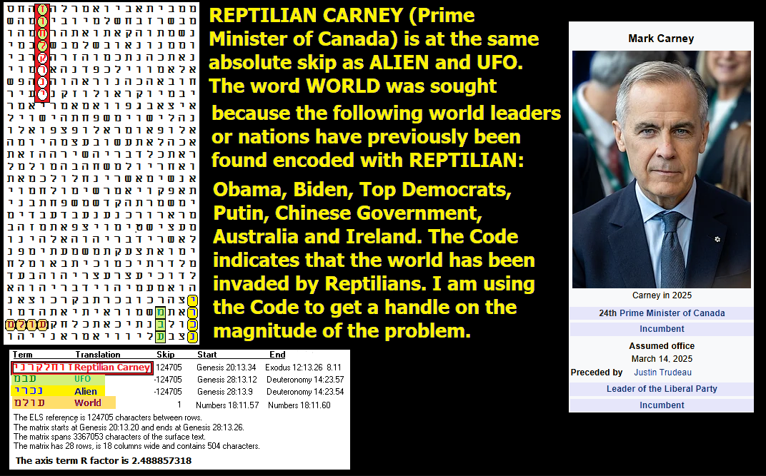

Slide 26
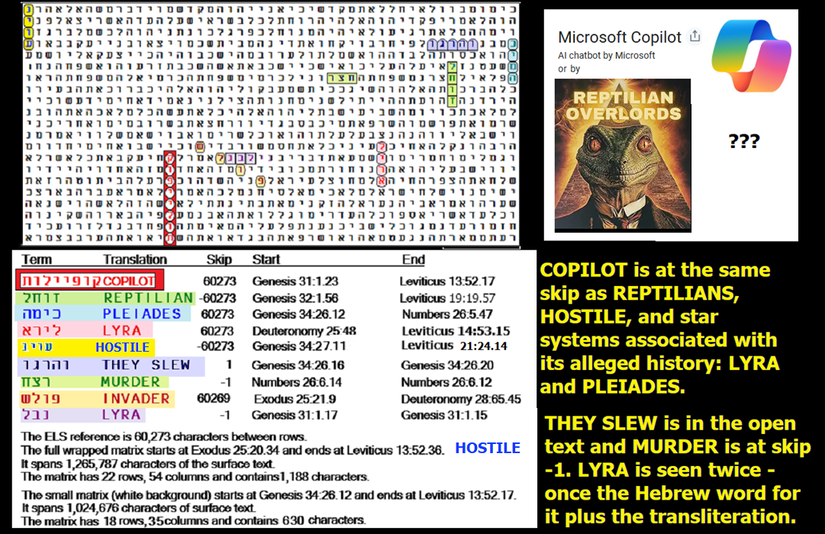

Slide 27
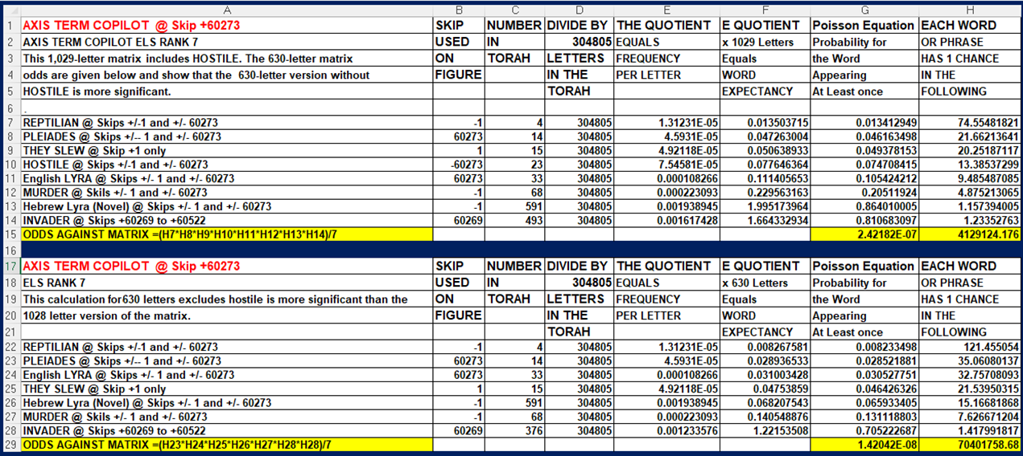

Slide 28
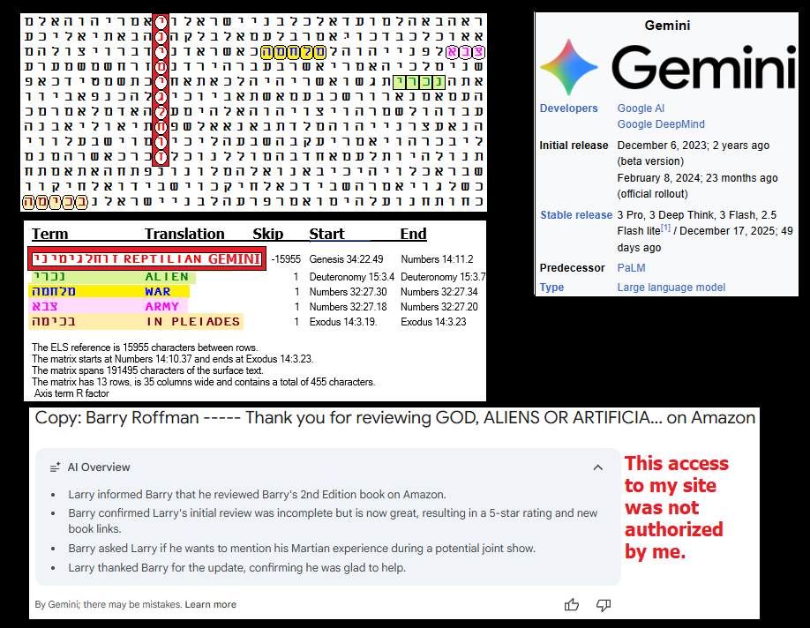

Slide 29
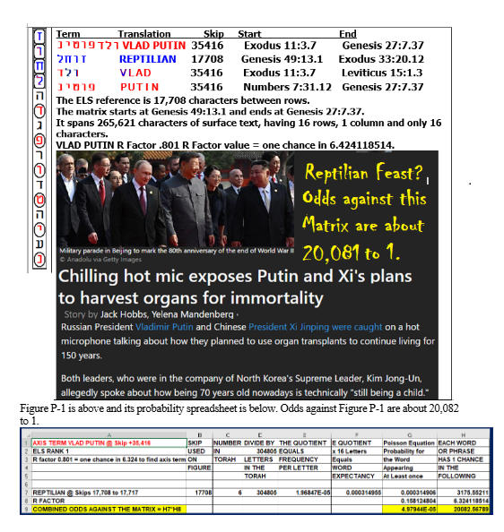

Slide 30
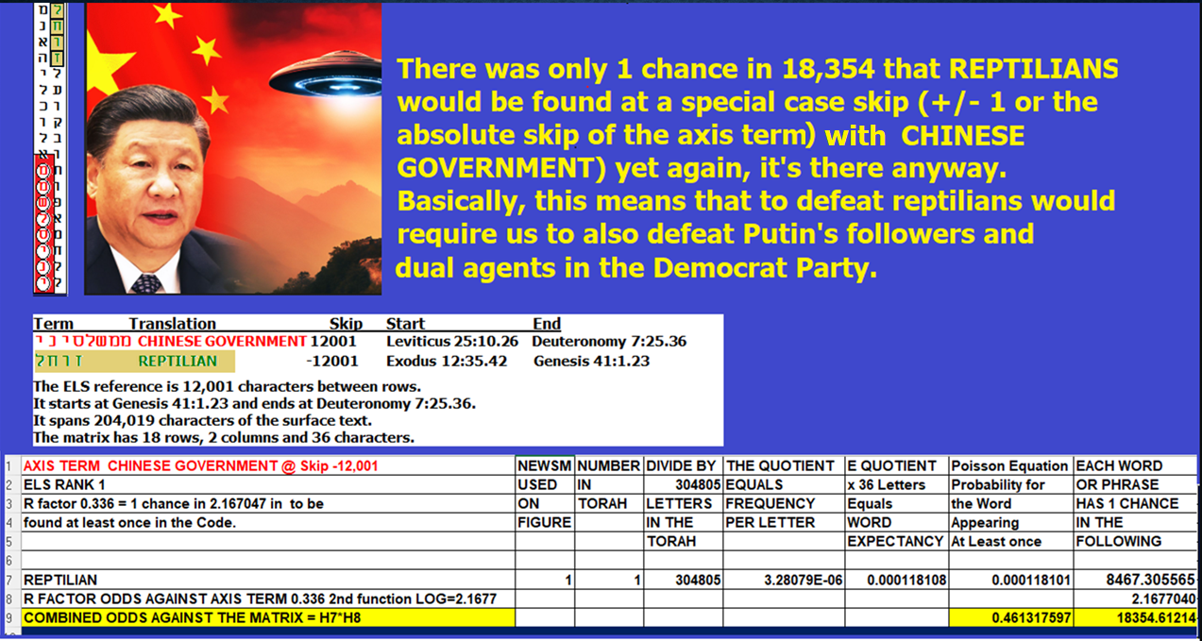

Slide 31
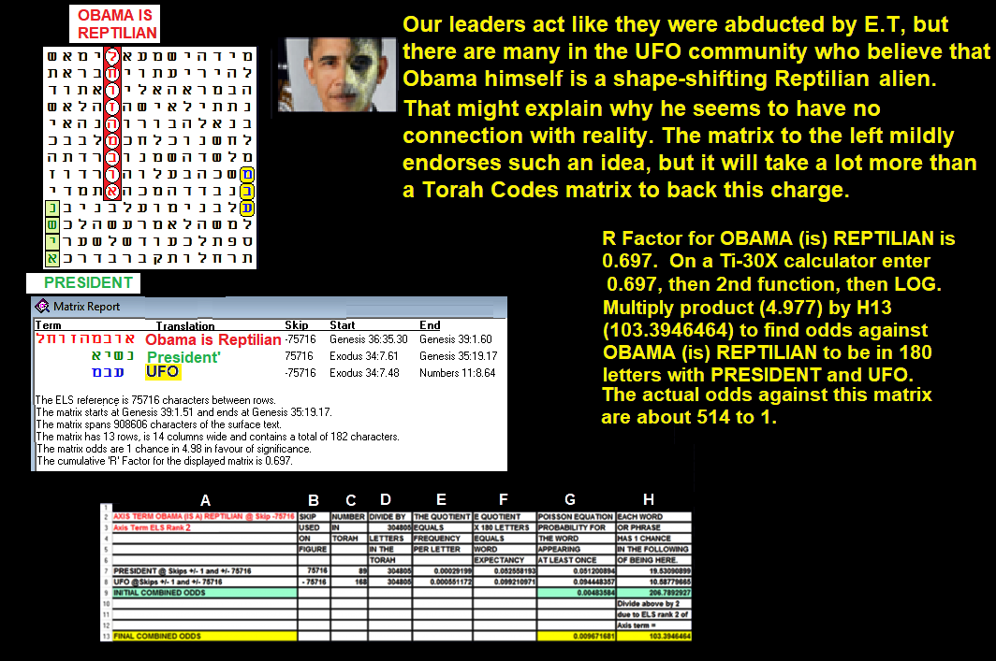

Slide 32
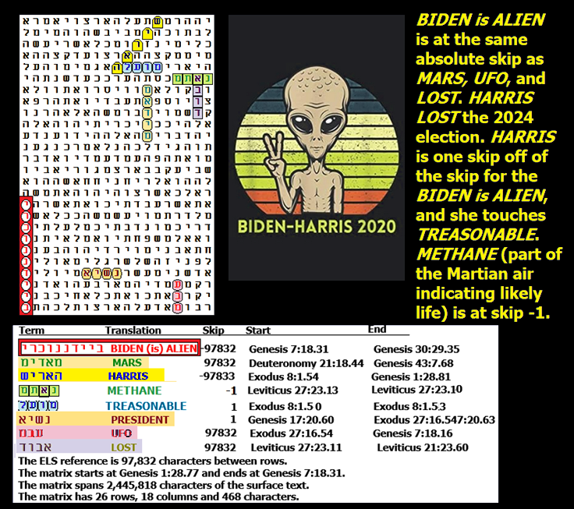

Slide 33
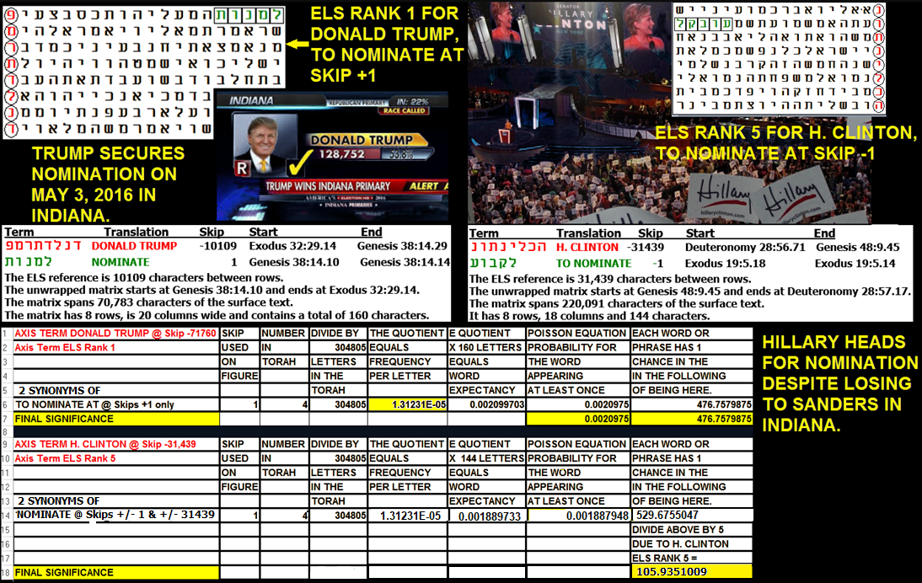

Slide 34
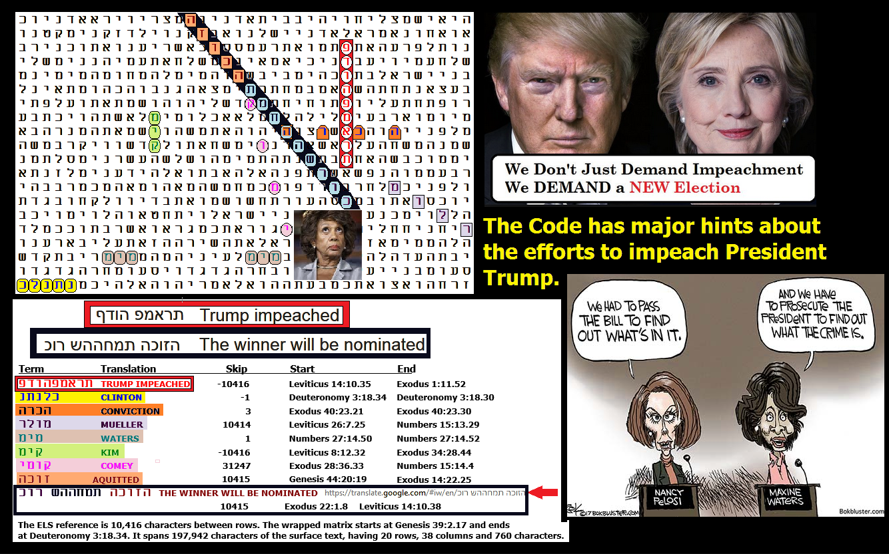

Slide 35
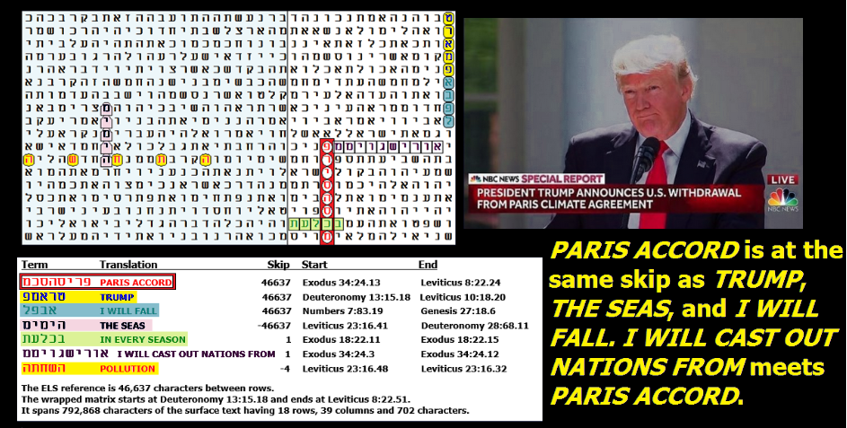

Slide 36
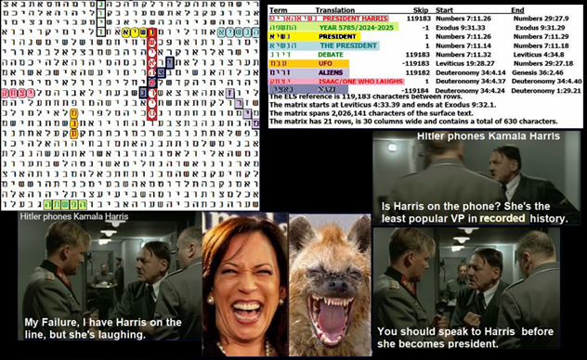

Slide 37
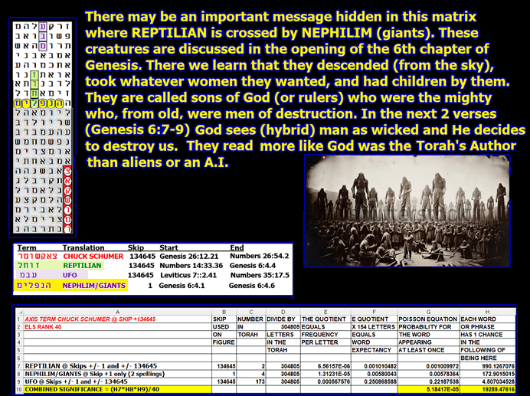

Slide 38
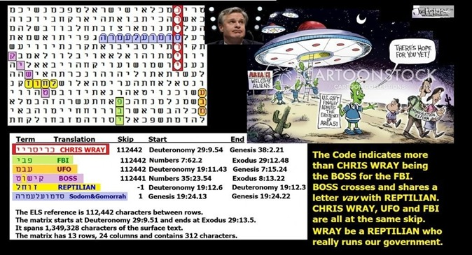

Slide 39
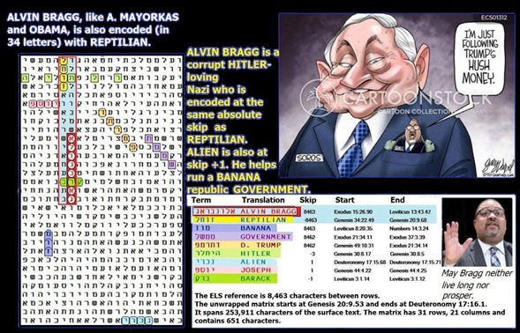

Slide 40
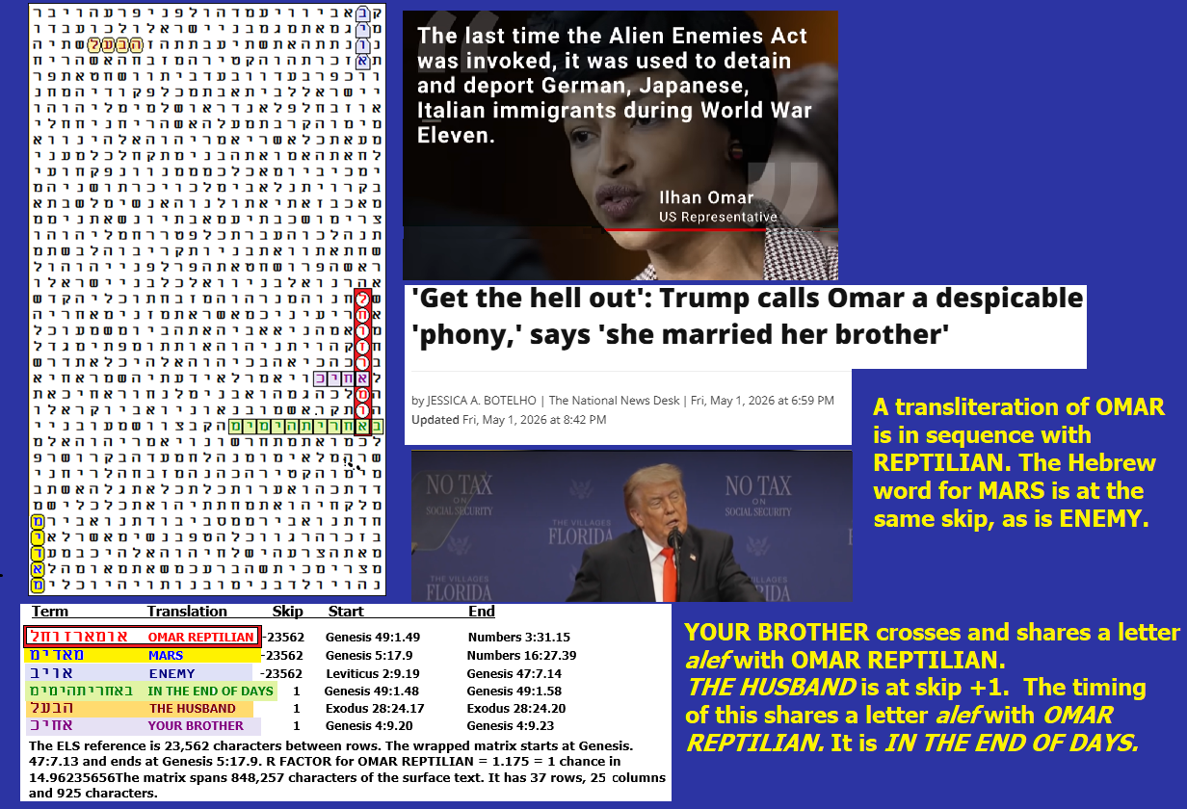
Note: This matrix was only found
on May 3, 2026 and is not yet in
my book.

Slide 41
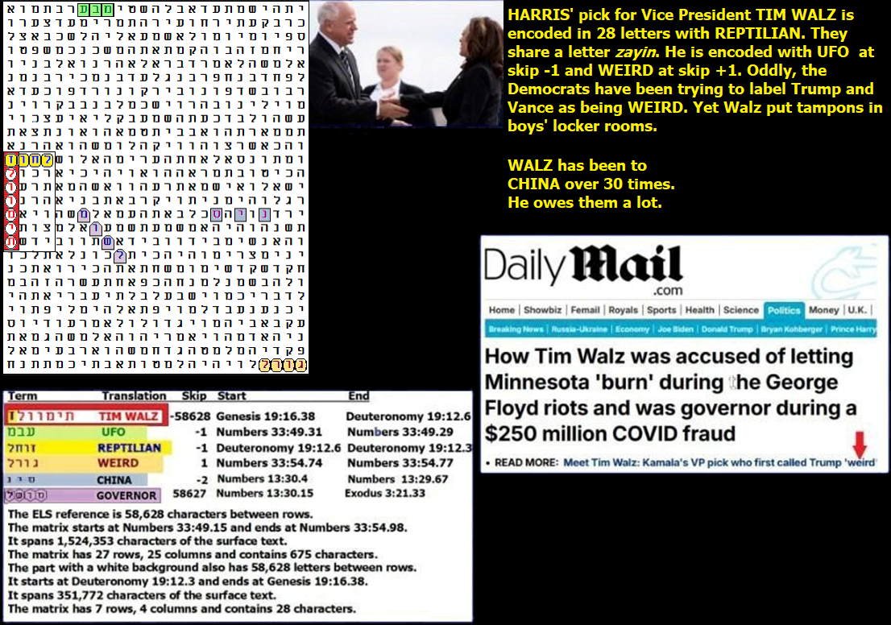

Slide 42
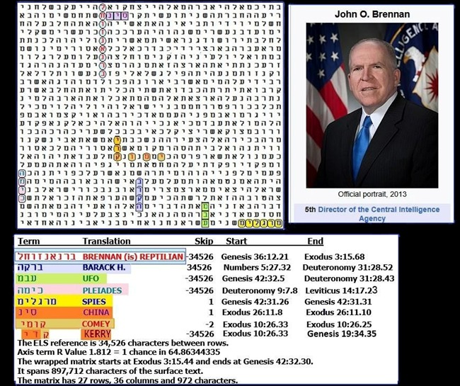

Slide 43
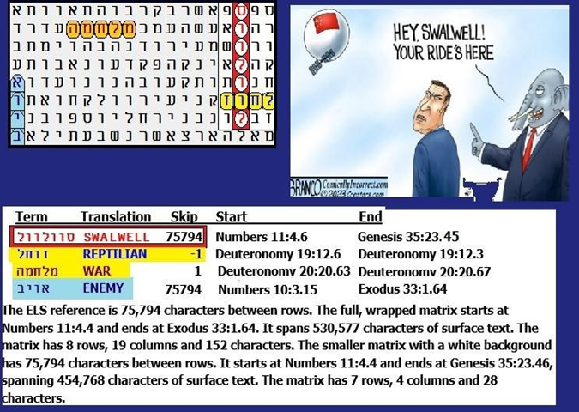

Slide 44
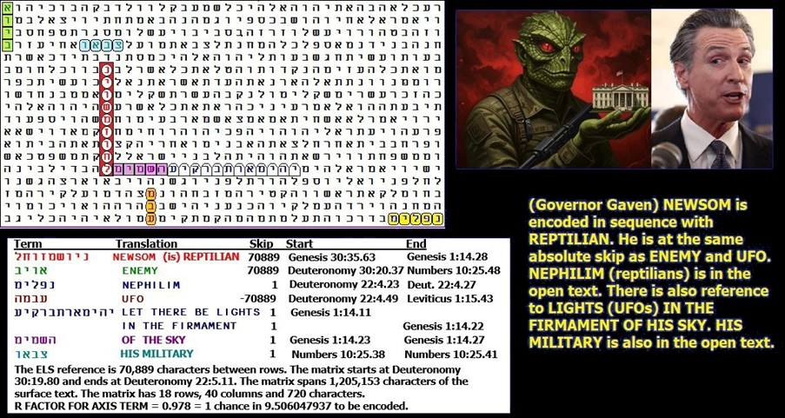

Slide 45
